Slide 1
Retirement 101
Michelle Martin,
Benefits Manager, Mmartin64@unl.edu
Benefits@unl.edu, 402.472.2600

Slide 2
Requirements of Retirement
Faculty and staff 55 and older are eligible to retire with ten years of service.
If you are age 62 or older, there is no service requirement to retire. You may retire at any time.

Slide 3
Health Insurance Options
Medicare
Advantage:
Cost effective with lower out-of-pocket costs when a supplemental is purchased
Disadvantages:
Not a global policy
Only available if 65 or older
If you enroll in Medicare after turning age 65 due to active employment, you will need to have a form completed by your benefits office to show you had credible group coverage while an employee.

Slide 4
Health Insurance Options
Retiree Insurance through the University
Advantages:
It is the same health and prescription coverage as active employees.
Retiree medical may be used as a Medicare Supplement and Prescription plan.
This may be a good option if you are under age 65 and need more than 18 months of coverage.
Disadvantages:
If you are over age 65 and not actively employed, this option is not considered credible coverage for Medicare.
This plan still has deductible and out of pocket expenses to meet.
Much more expensive than Medicare.

Slide 5
Health Insurance Options
COBRA
Advantages:
It is the same health and prescription coverage as active employees.
This may be a good option if you are under age 65 but within 18 months of being Medicare eligible.
Disadvantages:
More expensive than Medicare. If you have an option to enroll in Medicare or COBRA, choose Medicare.
Limit of 18-months of coverage.

Slide 6
Dental Insurance
You may remain on University Dental plan by completing an enrollment and direct debit form 31-days before retiring.
Same plan as active employee plan.
Retiree pays full cost on a monthly basis via debit directly from your bank account.
If the retiree passes away, the surviving spouse may remain on the plan by calling the Benefits Office.

Slide 7
Life Insurance
If you have voluntary life coverage you may contact Assurity to convert this policy into a personal policy. You will also want to indicate that you intend to enroll in this on our Retirement Benefits Enrollment form.
Under the employer-provided policy if you are under age 65, you are eligible to continue between $5,000 - $25,000 in coverage. Age 65-75 you may continue $5,000.
Following retirement, you will work directly with Assurity to set up any of these personal policies.

Slide 8
Long-term Care Coverage
If you have coverage through CNA or Genworth, you may continue this coverage by paying the carrier direct.
CNA (877) 895-6759
Genworth (800) 732-8353

Slide 9
Retirement Savings Accounts

Slide 10
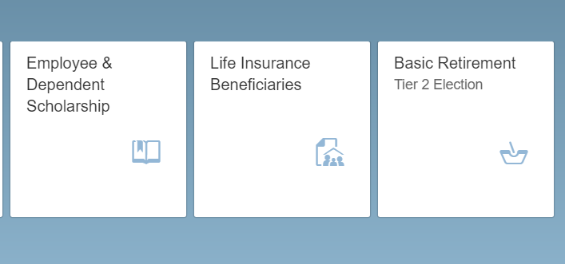
Are you on Tier 1 or Tier 2 of Basic Retirement plan?
Check Firefly to make sure you are enrolled in Tier 2.
An email is sent to all Tier 1 participants every May informing them they may change to Tier 2 during that month.
Tier 1 has a 3.5% employee contribution with a 6.5% match.
Tier 2 has a 5.5% employee contribution with an 8.0% match

Slide 11
Want a distribution?
Retirement plan accumulations may be accessed after termination of employment from the University and after your last paycheck has been deposited.
The required release form "Notice and Acknowledgement Regarding Retirement Plan Distributions" is available via DocuSign.
Upon receipt of the form and after the last paycheck has been deposited, we will notify the vendor your separation date and you may contact the vendor to request a distribution of your retirement funds.

Slide 12
Add a Supplemental Retirement Plan
403(b) and 457(b) Plan: Faculty and Staff, regardless of age, length of service, or benefits FTE, may participate in either or both the 403(b) and 457(b) supplemental plans.
2024 annual limits for both plans is $23,000 if under the age of 50 or $30,500 if you turn 50 years of age and older.
100% Voluntary and Employee funded.
You may elect a % or a fixed dollar amount, pre-tax and/or roth options
Contribution amounts may be changed at any time throughout the year.
Changes/enrollments can be completed in Firefly (forms no longer accepted)

Slide 13
One-on-one Appointment
Meet with your retirement vendor of choice to create a financial plan.
Appointments may be made by calling:
TIAA 1-800-732-8353
Fidelity 1-800-642-7131

Slide 14
In-Service Distributions
401a may be accessed by active employees 62 years or older and working 50% FTE or less.
403b may be accessed by active employees 59 ½ years or older no matter what FTE.
457b may be accessed by active employees if age 59 ½ years or older no matter what FTE.
For all, need a signed impact release form.

Slide 15
Other information
Update your personal information within Firefly.
Retirees and their eligible dependents may participate in the Tuition Scholarship program.
Vacation is an earned benefit and unused vacation will be paid out upon your retirement.
If you have a campus rec membership, athletic tickets, lied tickets, parking pass, etc., please contact those areas directly.
Thank you for coming!

