Slide 1
UNL Emeriti and Retirees Association
Our Goals:
EXPLORE NEW IDEAS
BE ENGAGED
STAY CONNECTED
SUPPORT UNL
ENJOY SOCIAL EVENTS

Slide 2
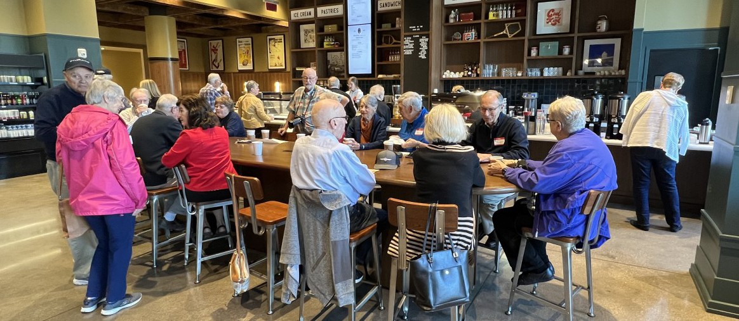
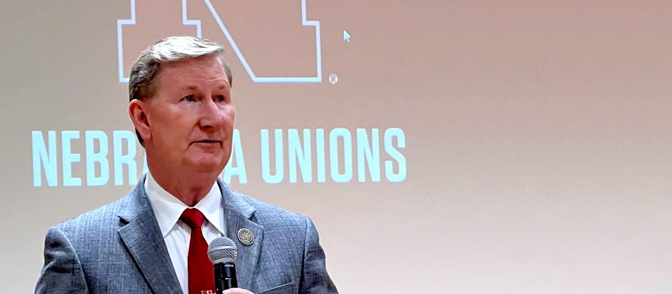
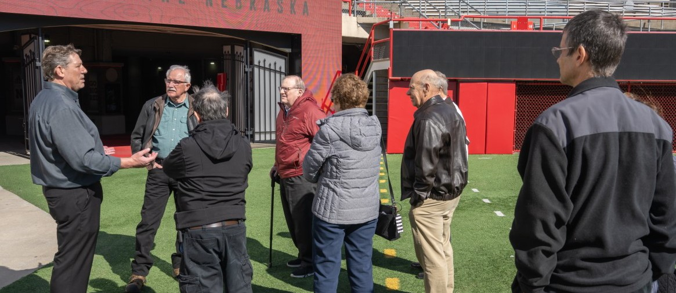
UNL Emeriti and Retirees Association
Friendly Informal Get-togethers
Luncheons with Outstanding Speakers
Exciting Tours & Activities

Slide 3
UNL Emeriti and Retirees Association
You Will Receive
Automatic ERA Membership When You Retire
First Year Membership Is FREE!
Dues Are Only $25/year Thereafter
More about ERA on our website
emeriti-retirees.unl.edu

Slide 4
UNL Emeriti and Retirees Association
Questions?

