Slide 1
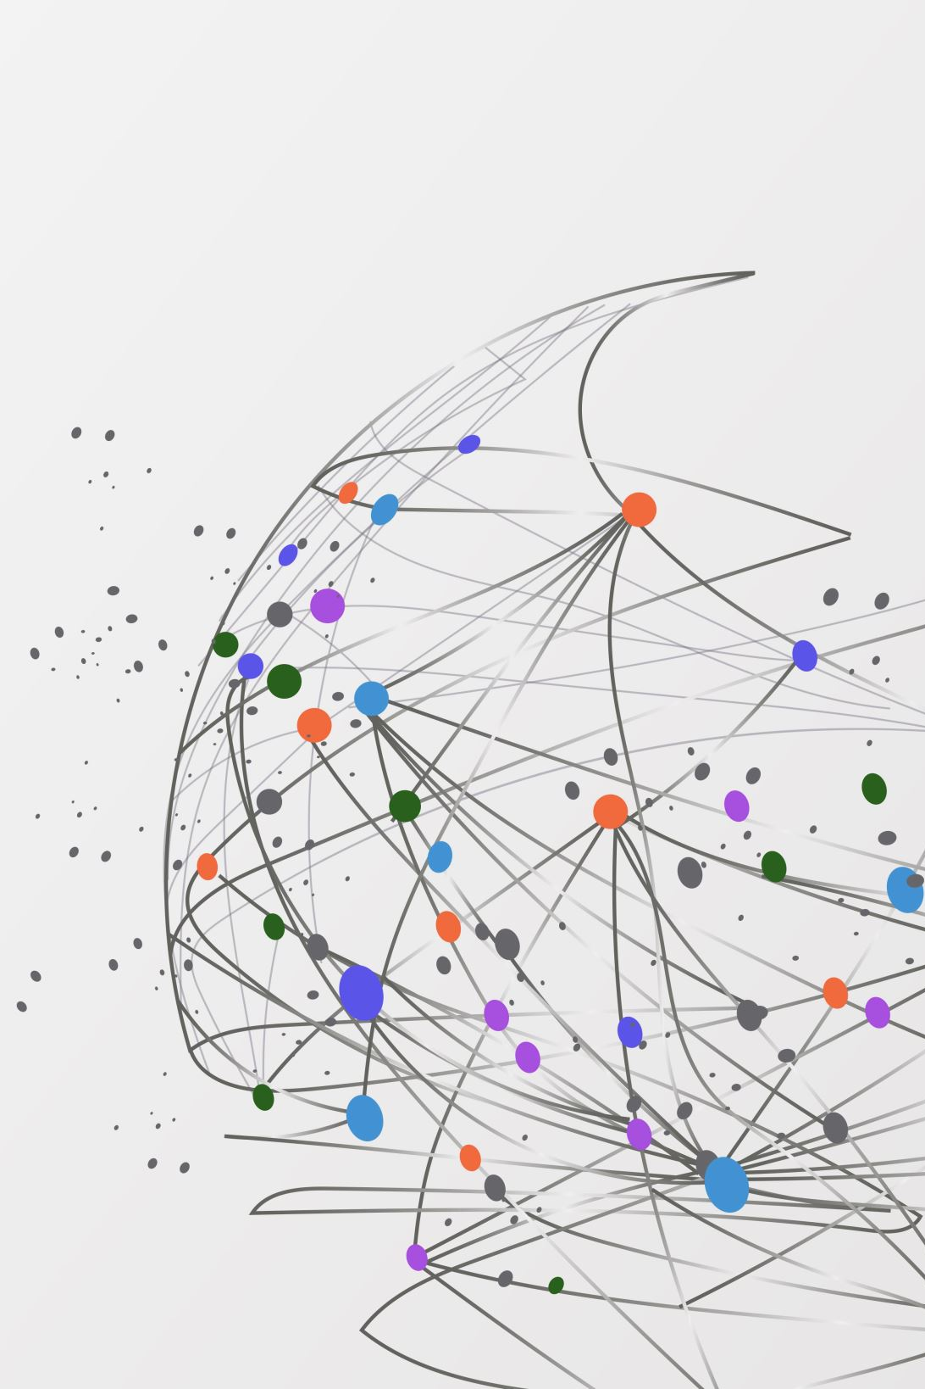
Succession Planning
preparing the Next Generation
Celeste Spier, PhD
Director of Organizational Development
UNL Human Resources
Notes:
INTRO: Hello, I’m Celeste Spier, Director of Organizational Development for UNL, which means I build and deliver leadership and professional development opportunities for staff here at UNL.
OPENING ACTIVITY – TBD
Calculate total numbers of years of experience of registered participants?
Personal story: “I’ve earned this knowledge, and I’m taking it with me!” – quote from former coworker?
Other ideas?

Slide 2
Succession Planning Truth v. Misconception
Continuity of operations
Ongoing
Important for every level
Notes:
When we think about succession planning, we often think about the process of selecting and grooming a specific individual to take over for another individual who is retiring, but succession planning is much broader than that and is ultimately about continuity of operations. Succession planning should be ongoing process of knowledge sharing and transfer at all levels to ensure the organization is functional no matter who comes and goes on the team.
Now, that may or may not be happening on your teams, but I’d like to give you some strategies today to assist with this process to ensure you are doing your part to ensure you team is successful after your retirement.

Slide 3
Reflection
I’m worried about being replaceable.
I’m worried about a loss of identity, prestige, or power.
I’m worried about not having purpose and meaning in my life.
I’m worried about being bored.
I’m worried about the future success of my team/organization.
I don’t completely trust anyone else to take over.
I don’t think anyone else will be as dedicated to this job as I am.
Notes:
Your readiness and willingness to share your knowledge with others could be affected by your thoughts and feelings about retirement.
These questions might help you think through some of those thoughts and feelings about transitioning out of your role and hopefully increase your willingness to share your expertise.

Slide 4
Supervisor Partnership
Notes:
This process should be a collaborative one, where you and your supervisor have many conversations over time about your transition and how to identify and best transfer your expertise.
While your supervisor should be the one taking the lead on this process, as we all know, day-of-day demands can often distract and prevent managers from taking an active role in this process – waiting until shortly before someone’s retirement date to initiate it. This often leads to an insufficient amount of time to transfer your knowledge and unpleasant experience for all involved.

Slide 5
Recommended Action Steps
Identify key tasks and knowledge
1
Select a method for transferring knowledge for each
2
Identify a timeline for knowledge transfer
3
Create training plans for specific tasks
4
Evaluate effectiveness
5
Notes:
Consider taking the lead on your succession plan.
Start by identifying the key tasks and knowledge you use in your role. Listing them out in a spreadsheet can be a helpful way to be thorough and stay organized.
Then, select a method for how you plan to transfer each task or area of knowledge
Switch to slide six (and then back)
Identify a timeline for reach. Depending on your role and level of expertise, the plan could take months or even years. A general best practice is to start the process one year in advance.
Create a training plan for specific tasks.
Evaluate its effectiveness. For example, after you’ve trained someone on one of your tasks, have them cover for you on you’re out of the office, and see how well they do.

Slide 6
Possible methods of knowledge transfer
Cross-train
Delegate or shift responsibilities
Shadowing
Write Standard Operating Procedures (SOPs)
Mentorship
Storytelling
Save docs in a shared location

Slide 7
Every person and every interaction matters.
Notes:
What you do over the next few months and years to prepare for your succession will have a great impact on your successor and your teammates. I hope that you generously share your expertise with the next generation of Huskers.
Thank you for your time today.

